Slide 1
Key logger and security
CAPSTONE PROJECT
Presented By:
MADHUMITHA.R-JKKNCET-B.TECH-IT

Slide 2
OUTLINE
Problem Statement (Should not include solution)
Proposed System/Solution
System Development Approach (Technology Used)
Algorithm & Deployment
Result (Output Image)
Conclusion
Future Scope
References

Slide 3
Problem Statement
In today's digital age, where cybersecurity threats loom large, one of the significant concerns is the proliferation of keyloggers, stealthy software tools designed to monitor and record keystrokes on a user's computer without their knowledge. Keyloggers pose a severe threat to individuals and organizations as they can capture sensitive information such as passwords, credit card details, and other personal data, leading to identity theft, financial loss, and privacy breaches.

Slide 4
Proposed Solution
To mitigate the threat of keyloggers and enhance cybersecurity, individuals and organizations can implement several strategies:
Use Antivirus and Anti-malware Software: Install reputable antivirus and anti-malware software on all devices. These programs can detect and remove keyloggers and other malicious software.
Keep Software Updated: Regularly update operating systems, applications, and security software to patch vulnerabilities exploited by keyloggers.
Employ Endpoint Security Solutions: Implement endpoint security solutions that include features like behavior monitoring, heuristic analysis, and real-time threat intelligence to detect and prevent keylogger activity.

Slide 5
Proposed Solution
Use Virtual Keyboards: Whenever possible, use virtual keyboards for entering sensitive information such as passwords and credit card details. Virtual keyboards help bypass hardware-based keyloggers.
Enable Two-Factor Authentication (2FA): Enable 2FA wherever available. Even if a keylogger captures passwords, it won't be able to access accounts without the second authentication factor.
Practice Vigilant Behavior: Be cautious when clicking on links or downloading attachments from unknown or suspicious sources. Educate employees and users about phishing techniques used to distribute keyloggers.

Slide 6
Proposed Solution
Implement Least Privilege Principle: Limit user privileges to only those necessary for their roles. This reduces the impact of a keylogger compromise by restricting access to sensitive data and systems.
Monitor Network Traffic: Employ network monitoring tools to detect any suspicious outgoing traffic from devices, which could indicate the presence of a keylogger sending captured data to a remote server.
Regularly Review Logs and Alerts: Regularly review system logs and security alerts for any signs of unusual activity that could indicate a keylogger or other security breach.

Slide 7
Proposed Solution
Encrypt Sensitive Data: Encrypt sensitive data both at rest and in transit to make it harder for keyloggers to capture useful information even if they manage to infiltrate a system.
Implement Physical Security Measures: Secure physical access to computers and other devices to prevent unauthorized installation of hardware keyloggers.
Conduct Employee Training: Train employees on cybersecurity best practices, including how to recognize and avoid keylogger attacks.

Slide 8
System Approach
The "System Approach" section outlines the overall strategy and methodology for developing and implementing the rental bike prediction system. Here's a suggested structure for this section:
Use Antivirus and Anti-malware Software
Keep Software Updated
Employ Endpoint Security Solutions
Use Virtual Keyboards
Enable Two-Factor Authentication (2FA)

Slide 9
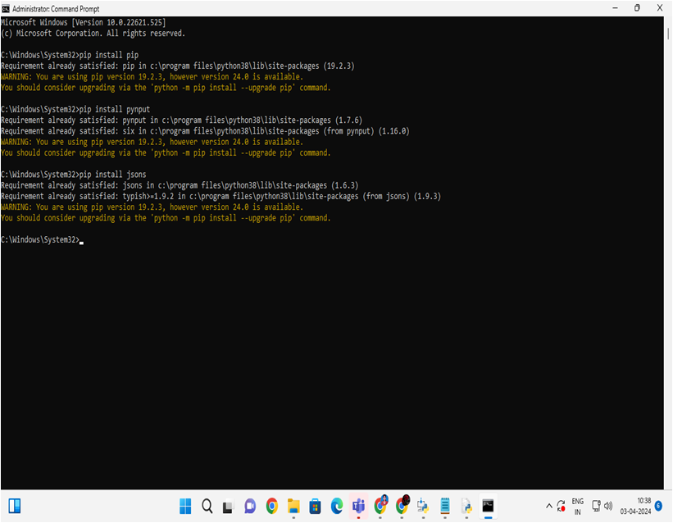

Algorithm & Deployment

Slide 10


Result

Slide 11
Conclusion
Summarize by adopting a multi-layered approach combining technical controls, procedural measures, and user education, organizations can effectively mitigate keylogger threats and safeguard against potential security breaches.

Slide 12
Future scope
The future scope for mitigating keylogger threats lies in the integration of advanced artificial intelligence algorithms for proactive threat detection, behavioral analysis, and automated response, alongside the development of secure hardware solutions resistant to keylogger attacks.

Slide 13
References
"The Complete Guide to Cybersecurity for Individuals and Organizations" by Bruce Schneier offers comprehensive insights into keylogger threats and mitigation strategies

Slide 14
THANK YOU

